Slide 1

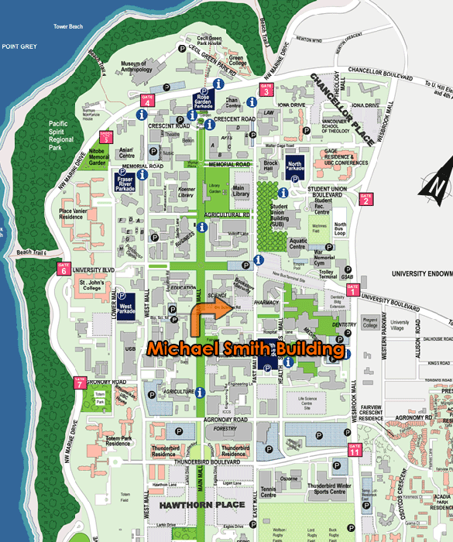

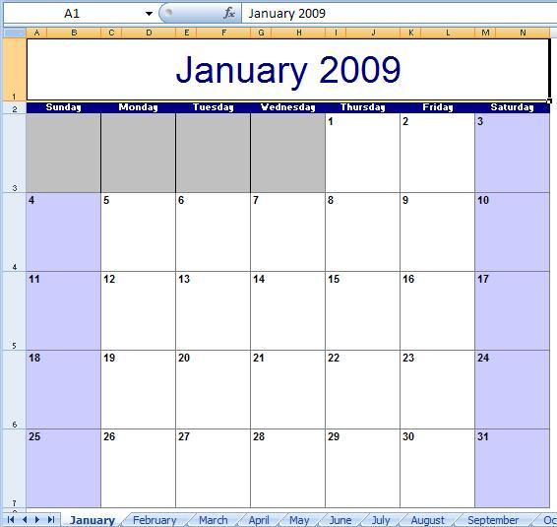
Main Panel
Title
Settings Tab
Tab Panel
Notification Tab
Friends Tab
Calendar Tab
File Upload Tab
Directory
Icons of Friends
Browse
Upload
Chat Window

Slide 2
DB
Data Access
Lolock Service
Message Service
Notification Service
Subscription Service
Account Service
File Upload
Calendar Service
Location Service
Network
Client GUI
Client GUI
Client GUI

Slide 3
Server
Calendar
Subscription Check
Update Calendar Event
User/
Update Calendar
Client1:Calendar Service
Client2:Calendar Service
Client3:Calendar Service

Slide 4
App Engine Data Store
Blackborad Architecutural Style
For
Notifications
Data Access by Service Objects
Publish/Subscribe
Publish
Person
Business/Event
Instructor
TA
Students

Slide 5
Pipe-and-filter Architecture for Notification Formatting
List of
Notification
Object
Formatting – Set bold underline, and/or italics
Panel - Widget
with formatting
text
DateStamp – Add
date/time of the
notification occured
Icon – Add
appropriate icon
Panel with Date
Background – Apply background color to indicate “old” or “new”
Panel with added icon

Slide 6
Message
App Engine Data Store
Update message database
Notify User AsyncCallBack when message available
CheckSubscription
Send Message to User
Chat Panel
Chat Panel
Subscribe
App Engine Data Store
1 Subscribe User/
Update Subscription
2 Notify User AsyncCallBack when available
4 Notify result
When available
3 Accept/Reject
Update subscription list data
Friends Service
Friends Service

Slide 7
